Slide 1
Veterinary Science CDE Get Excited, Be Prepared!
Melissa Dunkel
National FFA CDEs
November 29, 2012

Slide 2
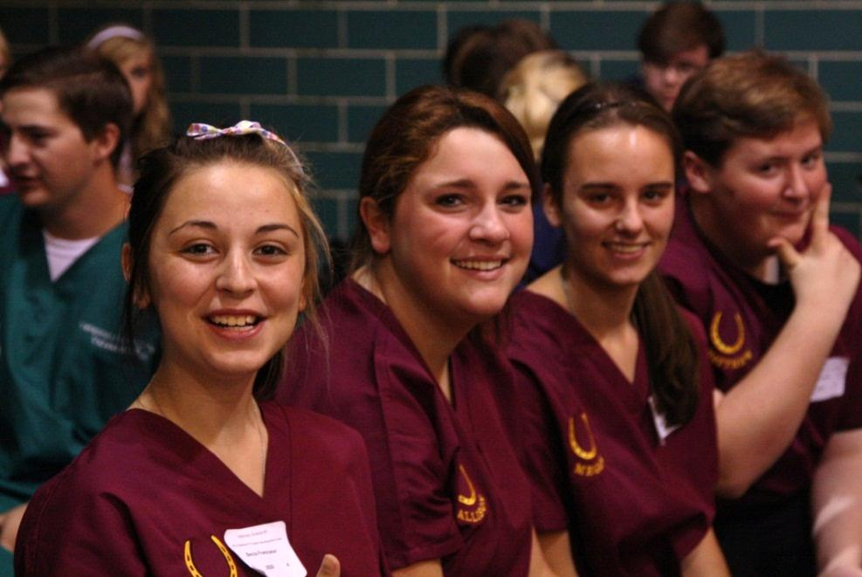
2012 Pilot Veterinary Science CDE
Wednesday
Team orientation meeting
Written exam
Math practicum
Identification
Written scenario
Thursday
Team activity
Handling and restraining practicum
Clinical procedures practicum
43 states
78 teams
310 individuals

Slide 3
Written Exam
50 multiple choice questions (60 minutes)
Exam and key handout (on website)
Adjusted #31 to accept A. liver and C. kidney
What to expect for next year:
Increased rigor of questions and answer choices
Additional resource on anatomy/physiology
Identification of exam-specific resources

Slide 4
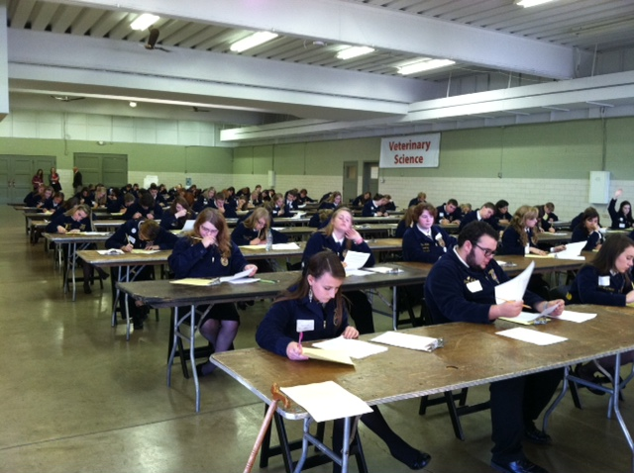
Math Practicum
23 multiple choice questions, 100 points (30 minutes)
Practicum and key handout (on website)
What to expect for next year:
Minor tweaks
More dosage questions

Slide 5
Scenario Questions
2 scenario questions (50 minutes total)
Scenario question, sample answer and rubric handout (on website)
What to expect for next year:
Topic: Clinical/wellness
Take time to research topic before event; do not rely solely on resources given at event

Slide 6
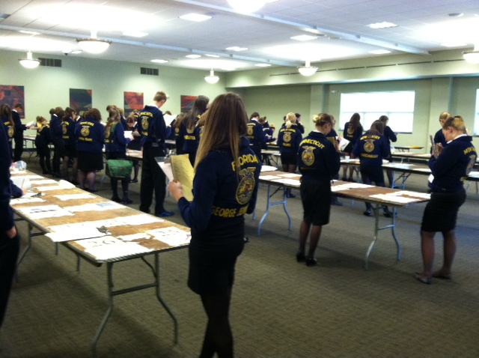
Identification
Equipment
25 questions, 50 points
Parasite
15 questions, 30 points
Breed
10 questions, 20 points

Slide 7
Identification (cont.)
What to expect for next year:
ID lists stapled together (3 different colors)
Clearer, non-pixelated photos
Potential use of real parasite specimen instead of just photos (changed in handbook)

Slide 8
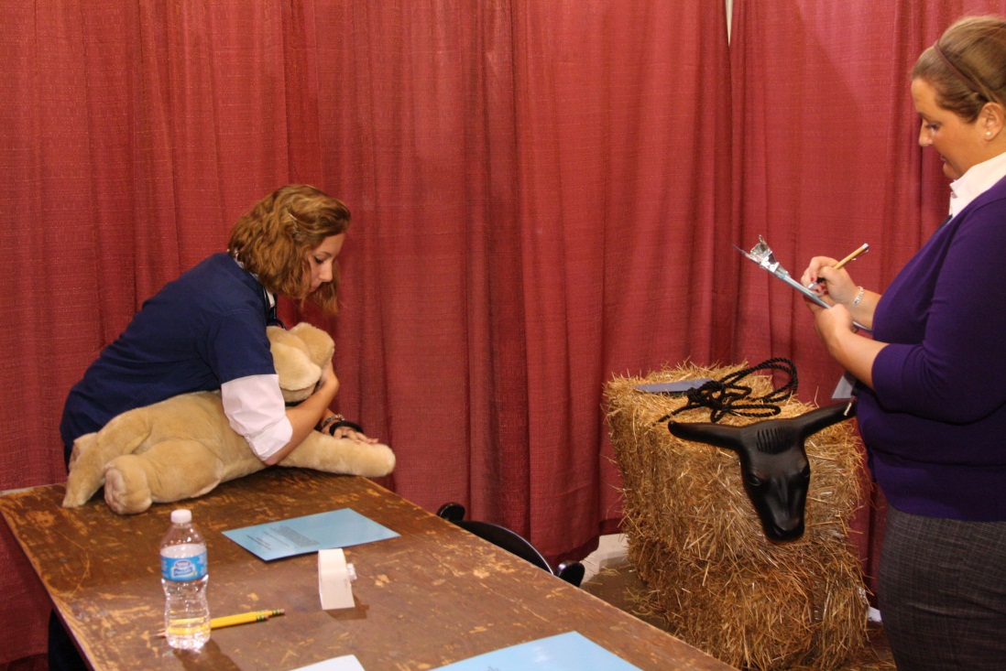
Handling and Restraining Practicums
Haltering Cattle
Cat “Stretch”
Restraint for Canine Jugular Venipuncture
Tie Bowline Knot
4 practicums; 25 points each
Practicum instruction handout (on website)

Slide 9
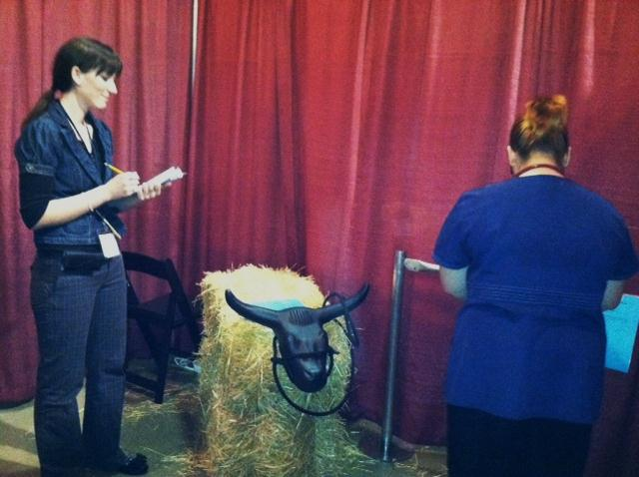
Handling and Restraining Practicums (cont.)
What to expect for next year:
Potentially narrowing practicum list each year
Students need to talk through practicum steps with judges (reminder added to each scorecard)

Slide 10
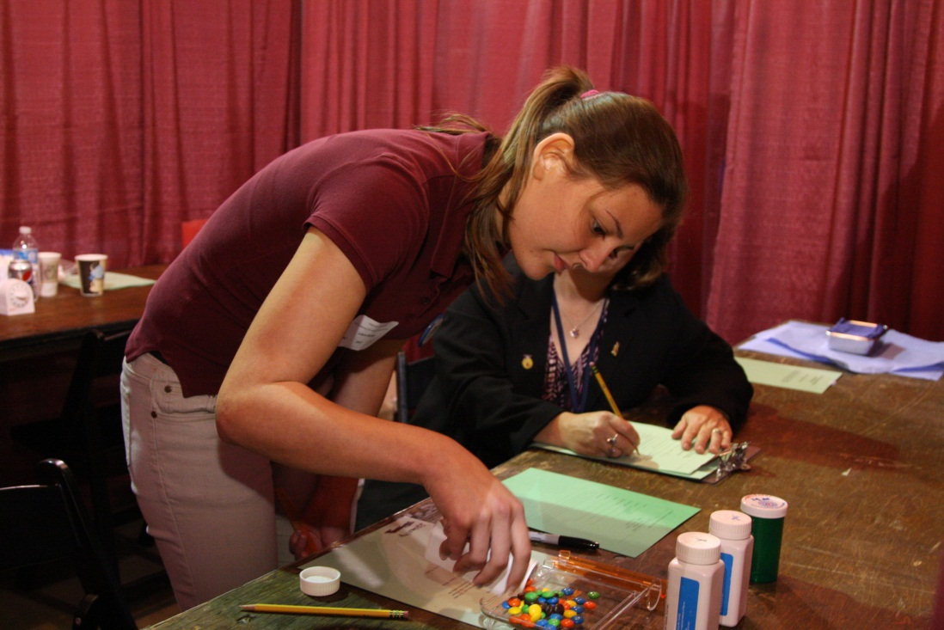
Clinical Procedures Practicums
Opening a Surgical Pack
Prescription Filling
Removal of Sutures
Subcutaneous Injection
4 practicums; 25 points each
Practicum instruction handout (on website)

Slide 11
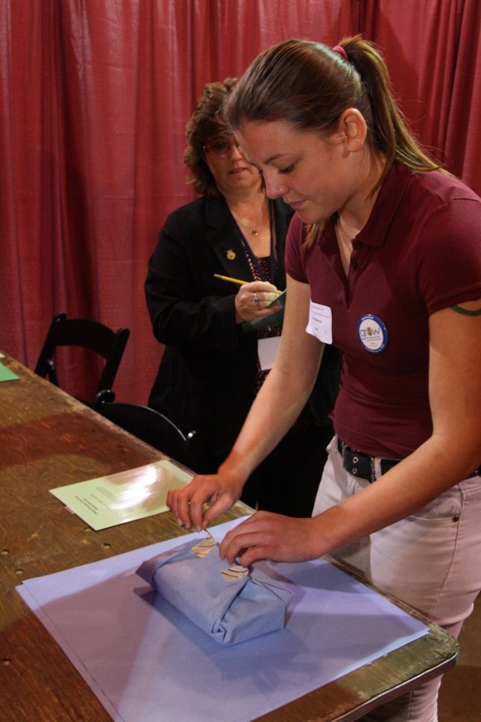
Clinical Procedures Practicums
What to expect for next year:
Math probably will not be included in practicums (prescription filling was a challenge this year)
Potentially narrowing practicum list each year
Students need to talk through practicum steps with judges (reminder added to each scorecard)

Slide 12
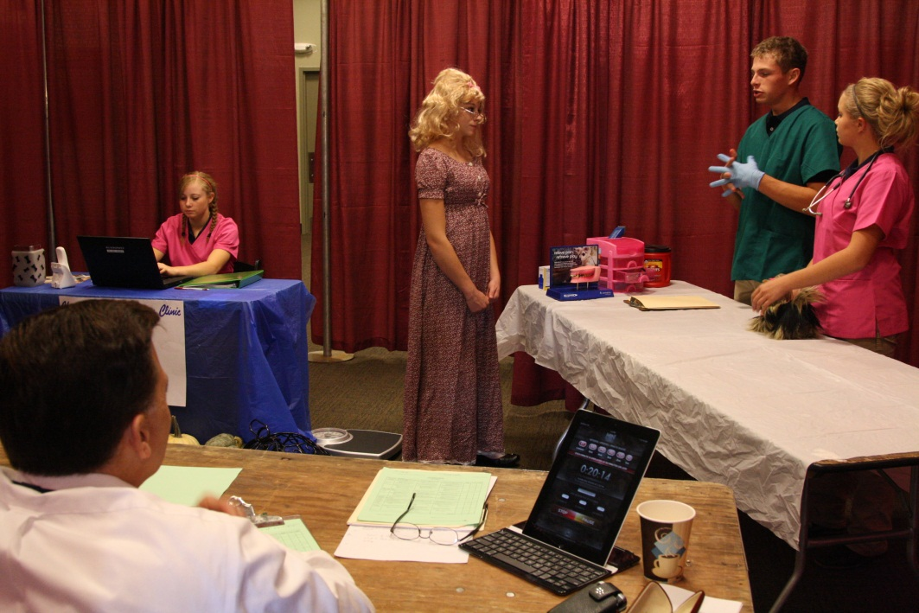
Team Activity
600 team points
Team activity scenario handout (on website)
Great feedback from judges about teams’ creativity and knowledge

Slide 13
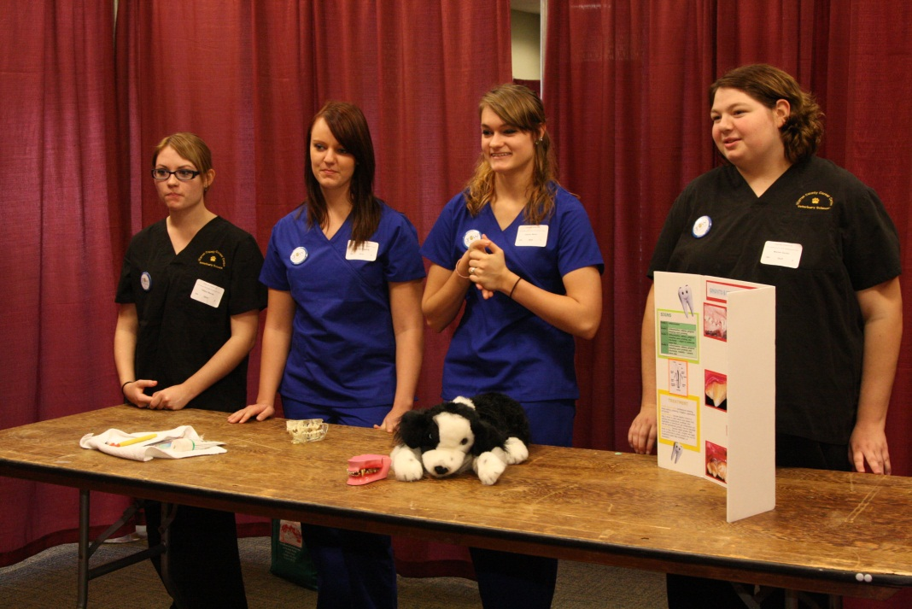
Team Activity (cont.)
What to expect for next year:
2013 topic: adult feline wellness visit (specifics released in team orientation packet, early August)
Judges will fill out presentation comments cards in future

Slide 14
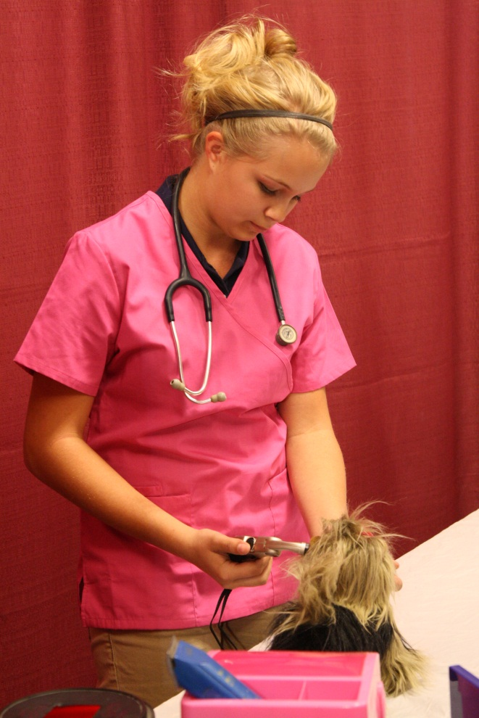
Team Activity (cont.)
What to expect for next year:
Keep in mind that props are good if they add to the presentation, but more important is for teams to have extensive topic knowledge
Conduct research at a few vet offices to get diversity of opinions/outlooks on topic

Slide 15
Other Helpful Resources
CDE handbook – ffa.org/cde
2012 pilot event review video – ihigh.com/ffa
Your local veterinarian or veterinary school
National FFA staff – Melissa Dunkel
mdunkel@ffa.org or 317-802-4288
Event superintendent – Paige Allen
pjones2@purdue.edu or 765-494-8635

Slide 16
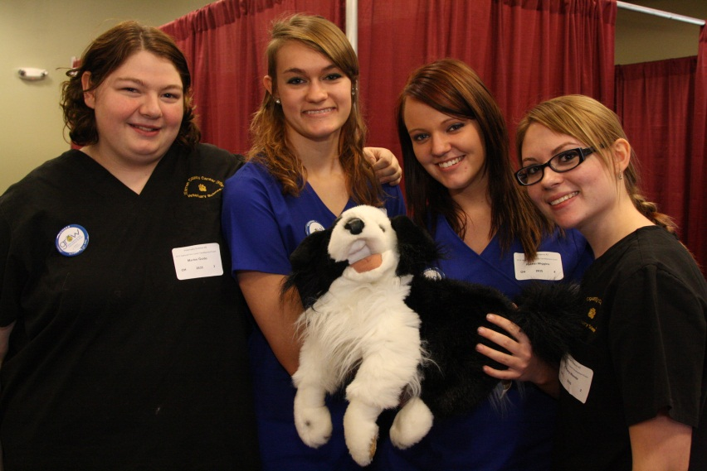
Questions?
Thank you!

